Slide 1

SWAN: Software-driven wide area network
Ratul Mahajan

Slide 2








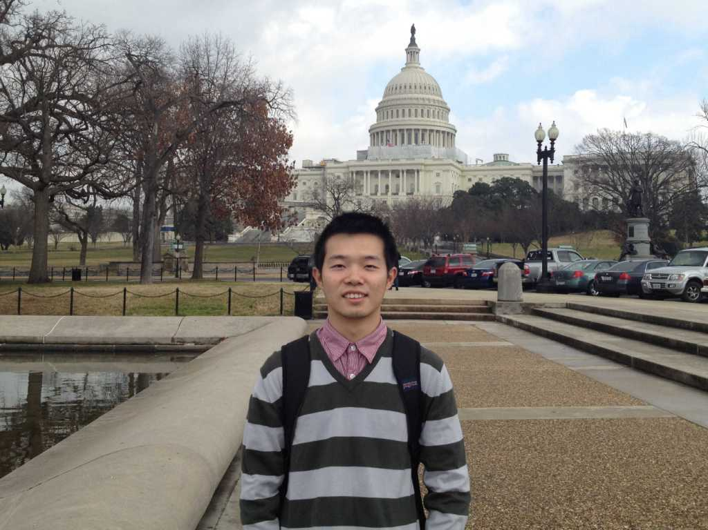



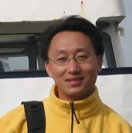
Partners in crime
Vijay Gill
Chi-Yao Hong
Srikanth Kandula
Ratul Mahajan
Mohan Nanduri
Ming Zhang
Roger Wattenhofer
Rohan Gandhi
Xin Jin
Harry Liu
Dave Maltz
Peng Sun
Lihua Yuan

Slide 3
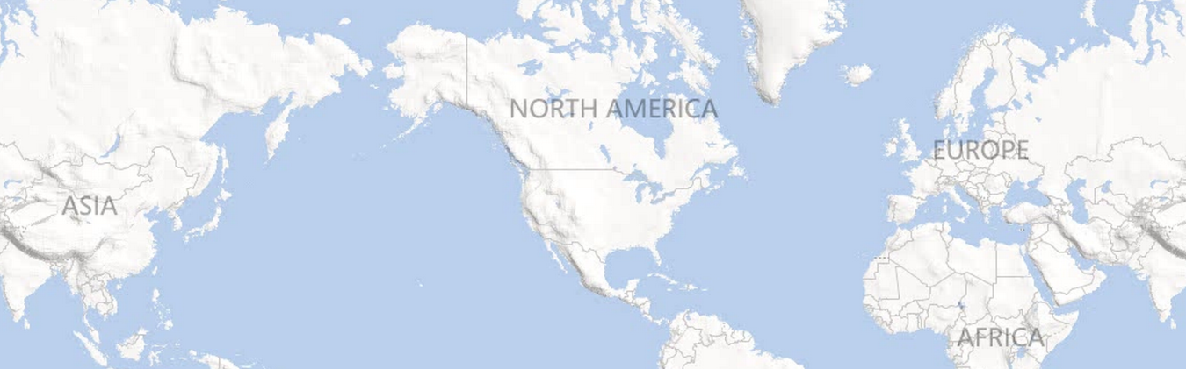
Inter-DC WAN: A critical, expensive resource
Dublin
Seattle
New York
Seoul
Barcelona
Los Angeles
Miami
Hong Kong
Notes:
Services need inter-DC WAN for performance and reliability.
100s of Gbps capacity over long distances.
Costs 100s of millions of dollars amortized annually.

Slide 4
But it is highly inefficient

Slide 5
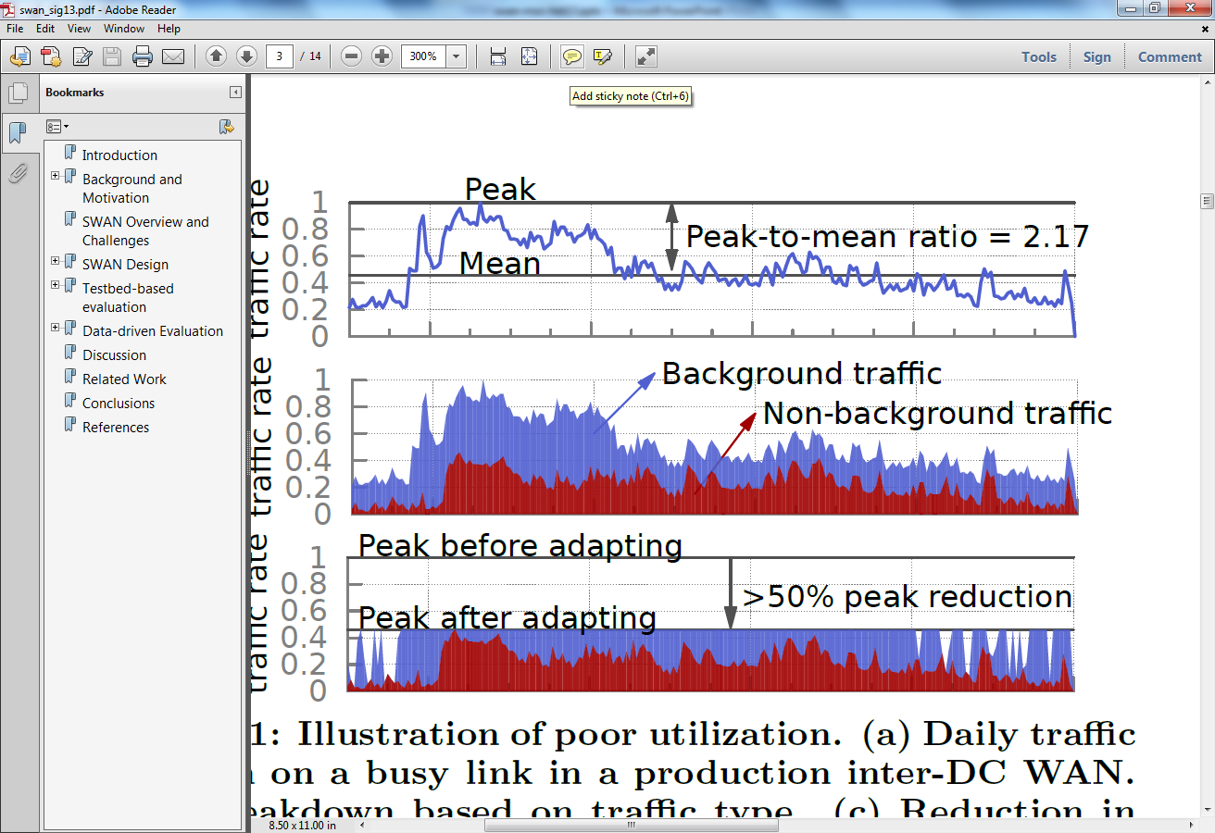
One cause of inefficiency: Lack of coordination
Notes:
Services send when they want and however much they want.
- leads to cycles of over and under-subscription
Poor utilization can be countered by leveraging traffic characteristics.
- some traffic can be delayed
Adapting this traffic will allow a smaller network to carry the same traffic or allow more traffic to be carried over a network.

Slide 6
Another cause of inefficiency: Local, greedy resource allocation
B
C
D
B
C
D
A
A
E
E
H
G
F
H
G
F
Local, greedy allocation
Globally optimal allocation
Notes:
Explain MPLS and tunnels.
Sub-optimality was observed in practice. [IMC paper]

Slide 7
SWAN: Software-driven WAN
Goals:
Highly efficient WAN
Support flexible sharing policies
Strict priority classes
Max-min fairness within a class
Key design elements:
Coordinate the sending rate of services
Centralized resource allocation
Notes:
Want network utilization to be upwards of 95% from the current standard of 40-60%
High efficiency alone is trivial to achieve; must support policies.

Slide 8

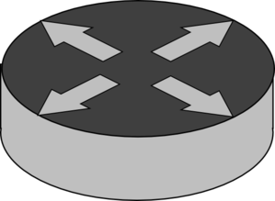

SDN primer
Networks today
Beefy routers
Control plane: distributed, on-board
Data plane: indirect configuration
SDNs
Streamlined switches
Control plane: centralized, off-board
Data plane: direct configuration
Notes:
Beefy routers are expensive
Control logic:
- Distributed means that its inefficient and does not enable direct, flexible control
- On-board means that bugs take a long time to detect and resolve
Streamlined switches:
retain only the forwarding component
Centralized control logic:
Centralized means its direct and flexible
We write it means that we have quickly detect and resolve issues
Network allocation is programmed directly into the forwarding filters

Slide 9



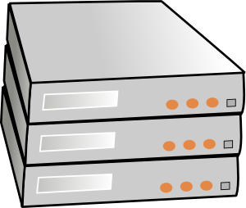
SWAN overview
SWAN controller
Traffic demand
Topology, traffic
BW allocation
Network config.
Service broker
Network agent
Rate limiting
WAN
Service hosts
[Achieving high utilization with software-driven WAN, SIGCOMM 2013]
Notes:
Bandwidth broker represents service hosts. Required for scalability and also allows for service-specific logic and policies.

Slide 10
Key design challenges
Scalably computing BW allocations and network config
Avoiding congestion during network updates
Working with limited switch memory

Slide 11
Scalably computing allocation
Path-constrained, multi-commodity flow problem
Allocate higher-priority traffic first
Fair within a class (weighted, max-min)
Solve at the granularity of DCs
Split DC-level allocation fairly among services
Derive switch configuration by leveraging network symmetry
Notes:
Allocate resources to higher priority traffic first, along shorter paths.
Then allocate lower priority traffic.
Flexible allocation
Fixed number of iterations and provable bounds on unfairness

Slide 12
Achieving Max-Min Fairness
Why is network-wide max-min fairness hard?
Requires progressive water filling
Freeze rates whenever a link becomes congested
Our approach
Geometrically partitions the rate space with param α
At i’th step, classes receive rate up to α^{i}U
If class gets lower rate, then its rate is held fixed in subsequent iterations
We prove that rates within [1/ α, α] of fair rate

Slide 13
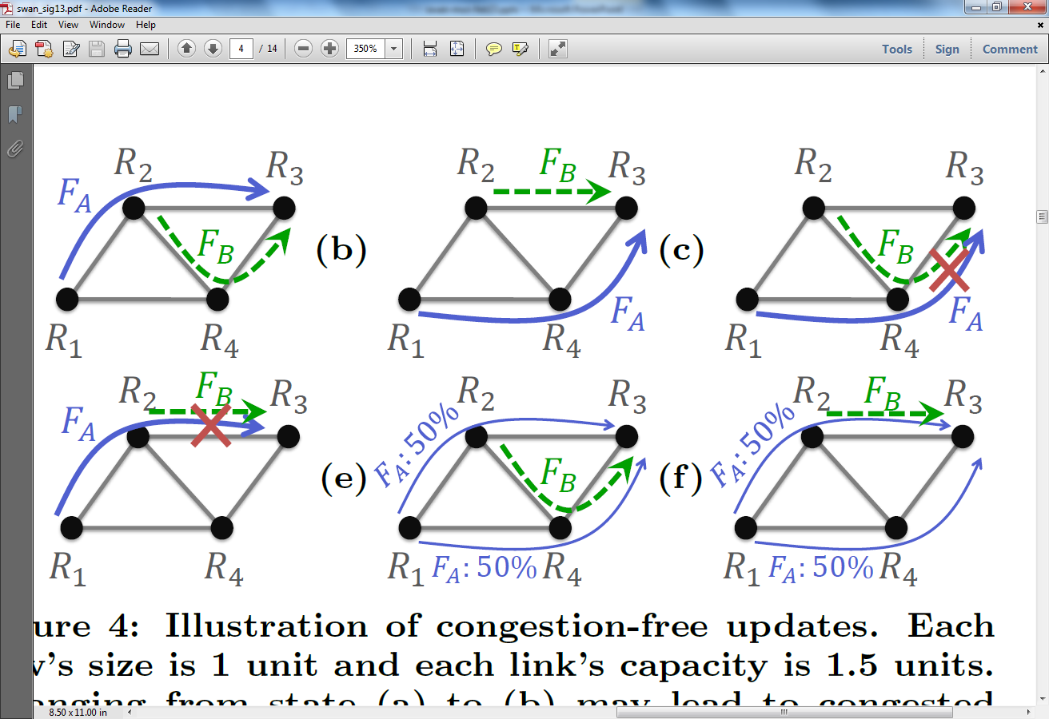
Congestion during network updates

Slide 14
Congestion-free network updates

Slide 15
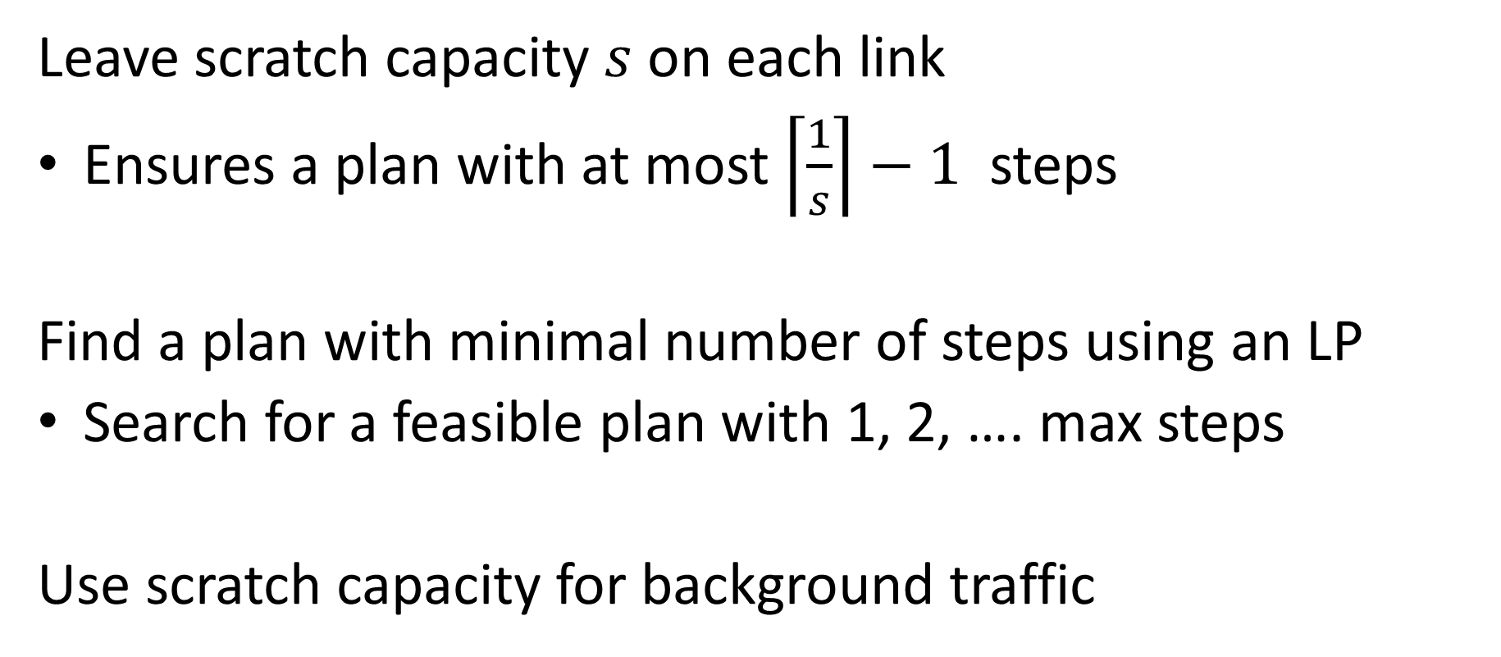
Computing congestion-free update plans
Leave scratch capacity $s$ on each link
Ensures a plan with at most $\left\lceil \frac{1}{s}\right\rceil −1$ steps
Find a plan with minimal number of steps using an LP
Search for a feasible plan with 1, 2, …. max steps
Use scratch capacity for background traffic

Slide 16
Working with limited switch memory
Use tunnel-based forwarding
Install only the “working set” of tunnels
Efficient mechanisms to update the set
Notes:
Also, simplifies updates.

Slide 17
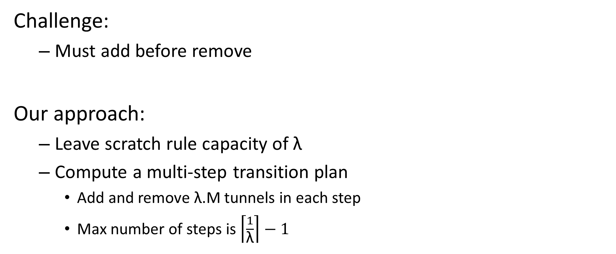
Updating the set of tunnels
Challenge:
Must add before remove
Our approach:
Leave scratch rule capacity of λ
Compute a multi-step transition plan
Add and remove λ.M tunnels in each step
Max number of steps is $\left\lceil \frac{1}{\text{λ}}\right\rceil −1$

Slide 18
Workflow in each epoch
Compute bw allocation, network config.
Compute rule change plan
Compute bounded-congestion plan
Notify services with lower allocation
Update the network
Notify services with higher allocation

Slide 19
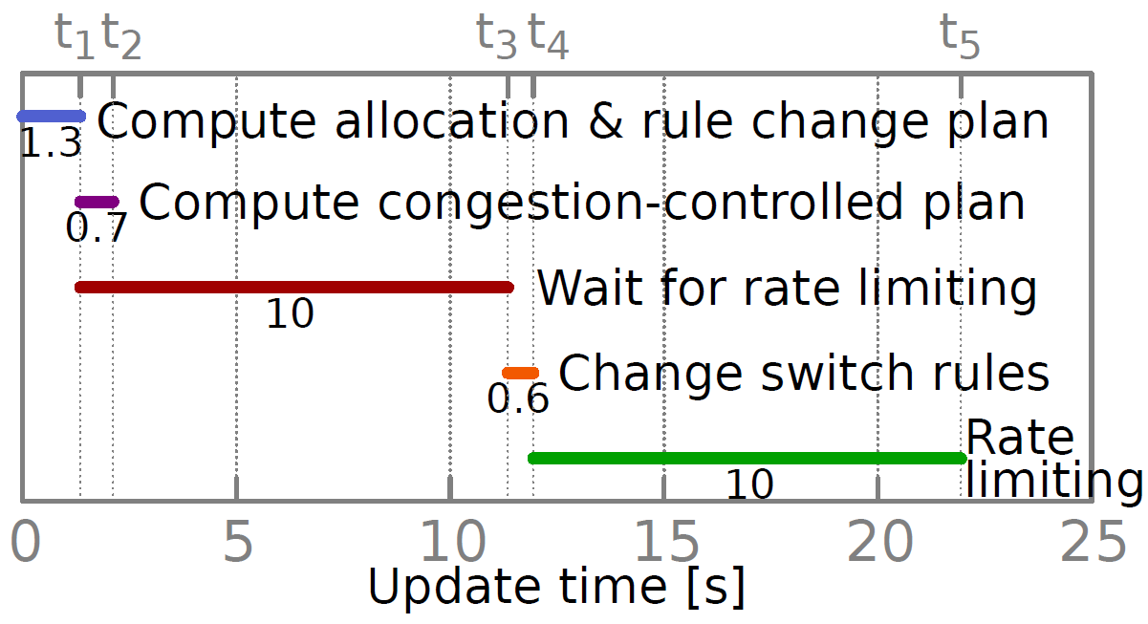
Workflow in each epoch

Slide 20
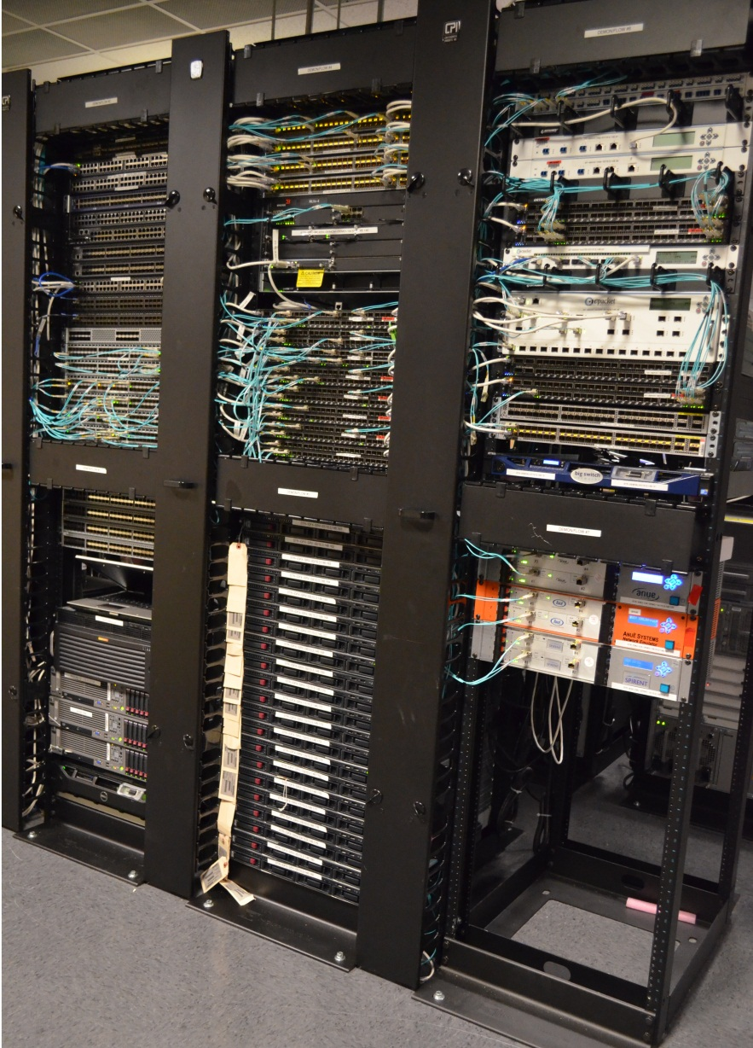
Prototype
16 OpenFlow switches
Mix of Blades and Aristas
BigSwitch OpenFlow controller
32 servers as traffic sources
25 virtual hosts per server
8 routers (L3)
Mix of Cisco and Juniper

Slide 21

Demo

Slide 22
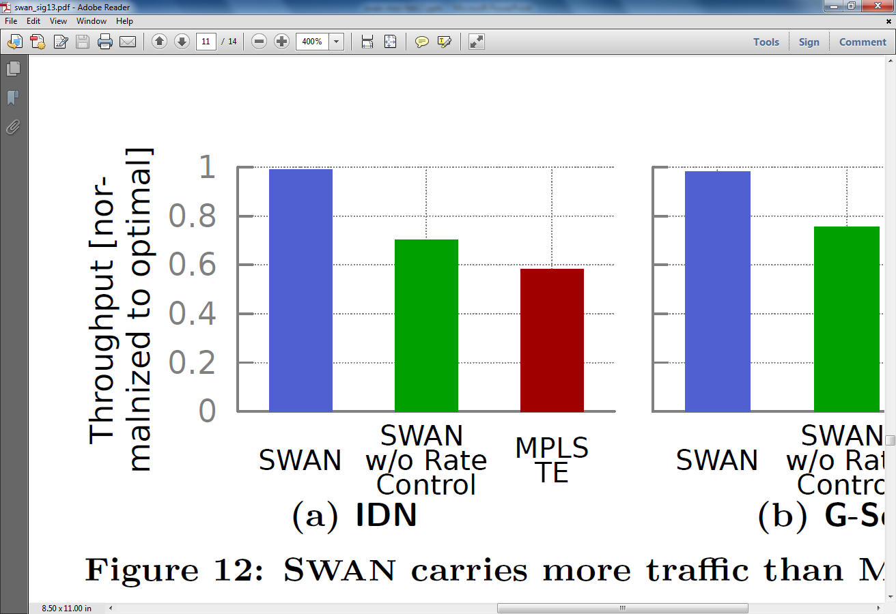
SWAN comes close to optimal
Throughput
(relative to optimal)
SWAN
SWAN
w/o rate control
MPLS TE

Slide 23
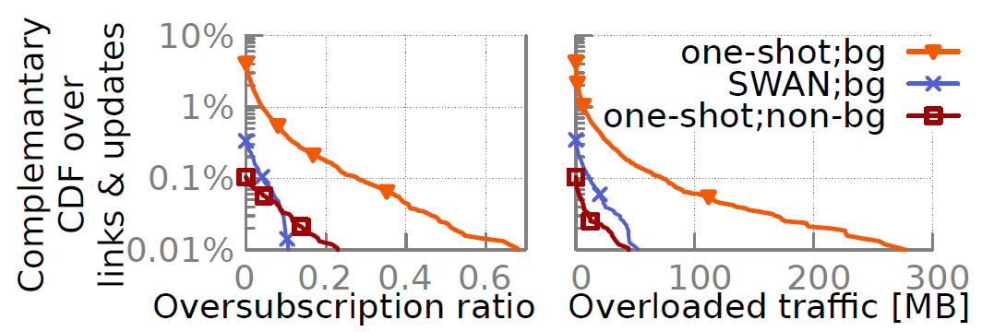
Network updates: SWAN provides congestion-controlled updates

Slide 24



Ongoing work
Wide-area pilot
Resilience to failures and uncertainty
Algorithms for local failure recovery
Fast application of updates
Robust switch software
WAN
Data center

Slide 25
Summary
SWAN yields a highly efficient and flexible WAN
Coordinates transmissions of services
Allocates resources centrally
Manages transitions by using scratch link and memory capacity
High efficiency is key to cost-effective cloud services
Many avenues for impactful research
Opportunity to be “clean slate”

Slide 26
Backup

Slide 27
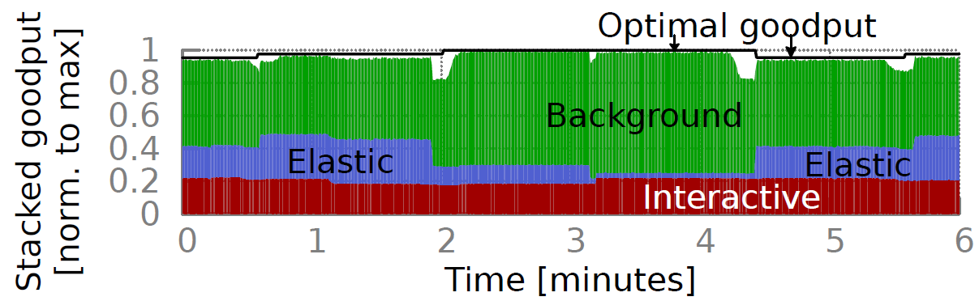
SWAN comes close to optimal (testbed)

Slide 28
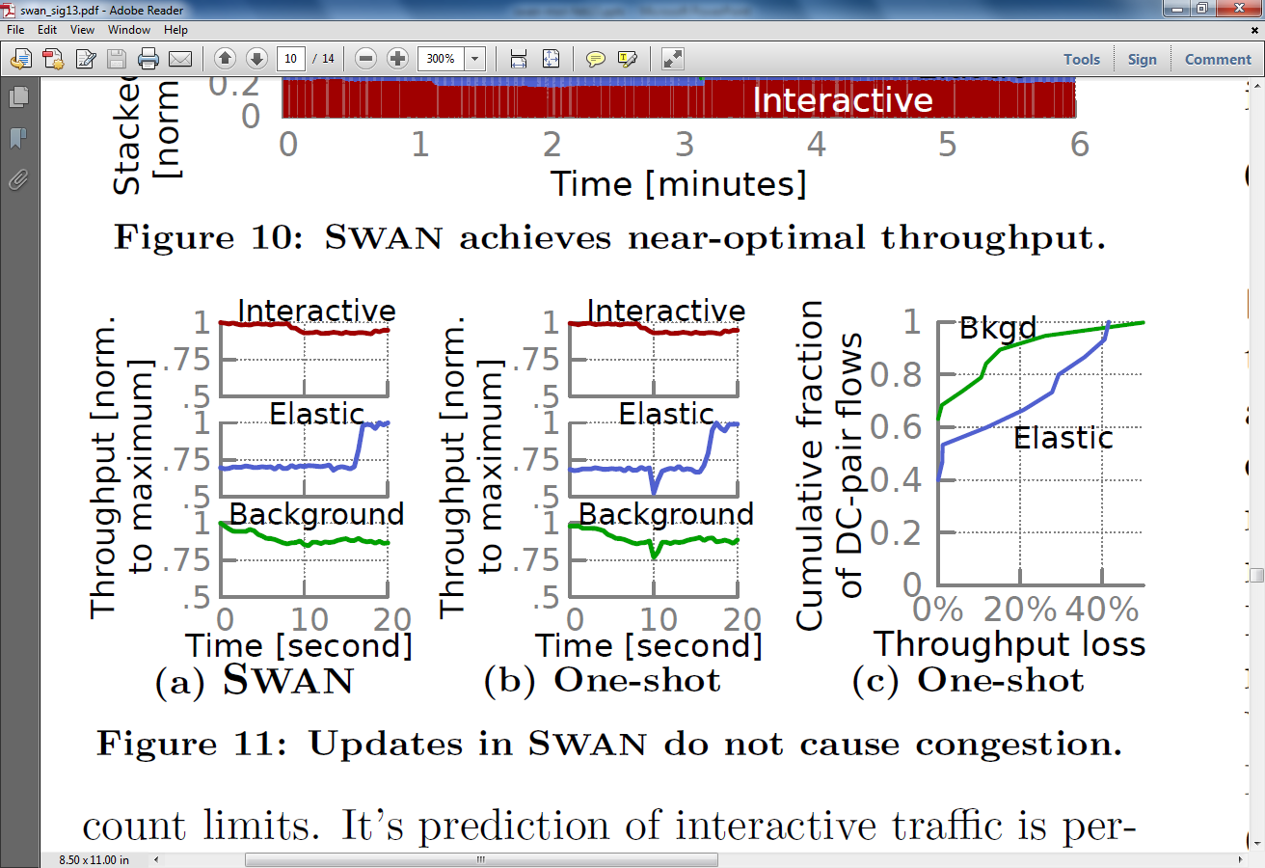
No transient congestion during updates with SWAN
One shot updates
SWAN

Slide 29
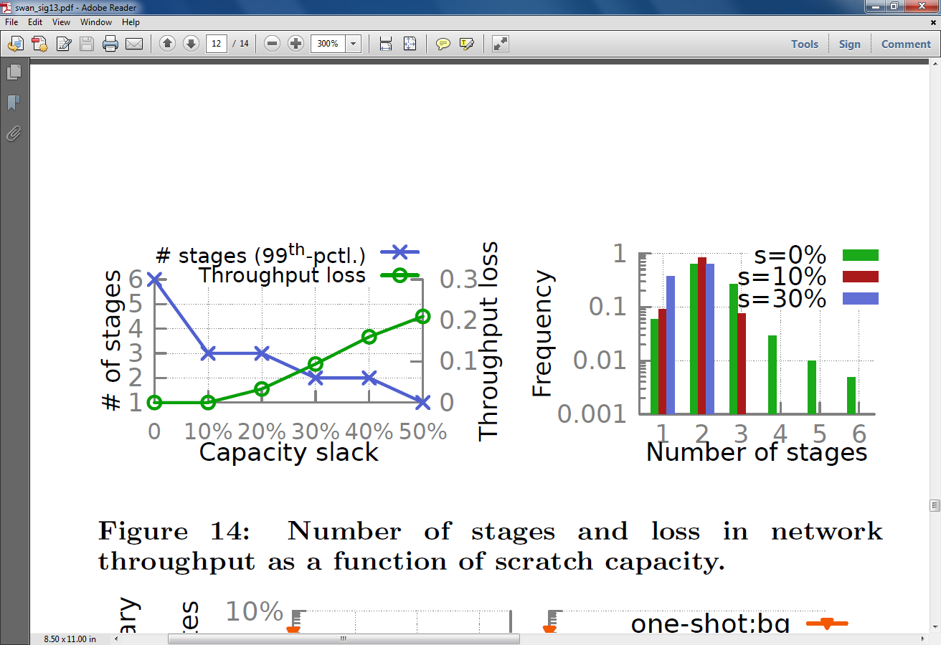
Network updates: Impact of s
s = ~10% leads to quick updates and little throughput loss

Slide 30
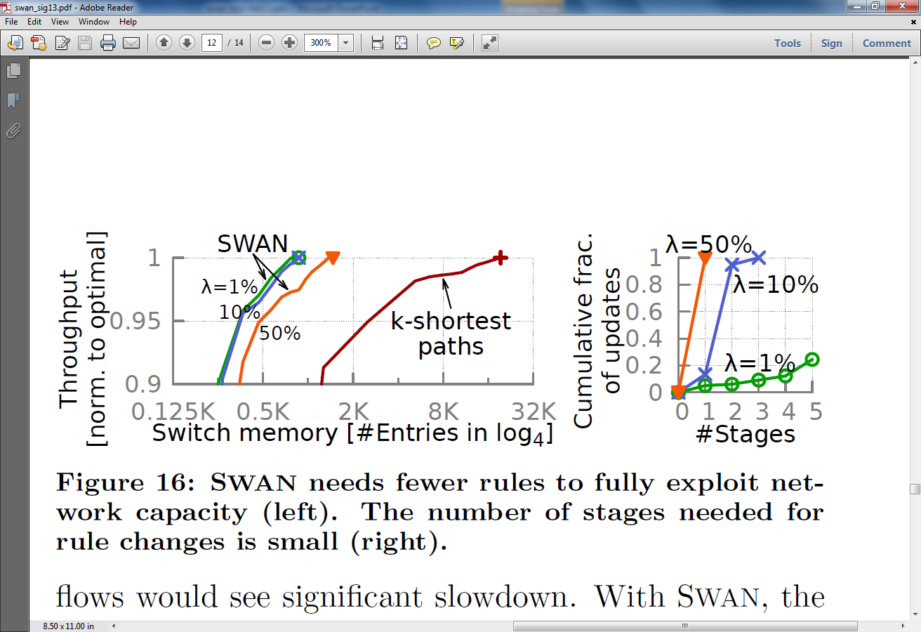
SWAN’s dynamic tunnel management needs little memory and is nimble

